Slide 1
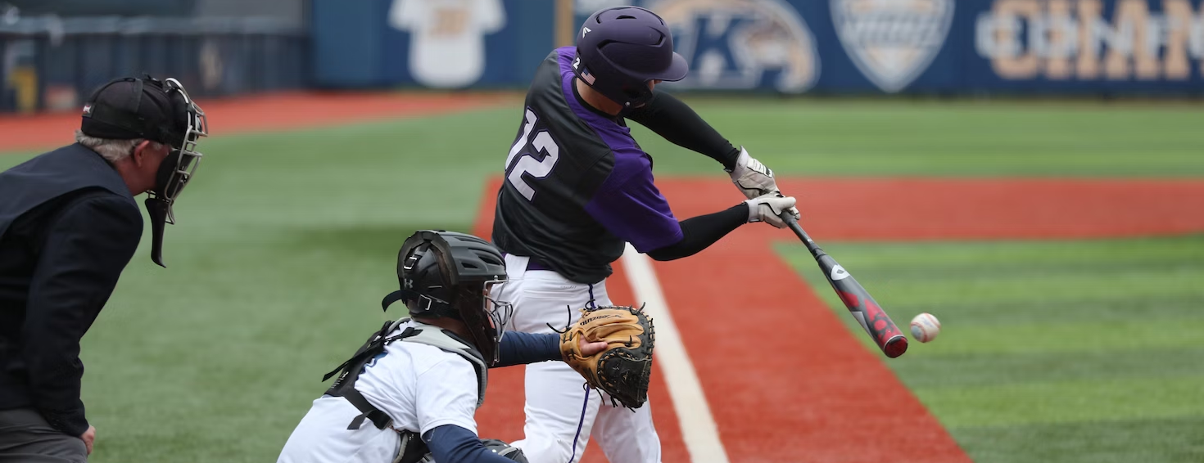
BASEBALL
STATISTICS
An Analysis on
Baseball Strategies
BY RAYAH MIAN

Slide 2


Introduction
BASEBALL STATISTICS
BUSINESS PROBLEM
Our objective is to investigate the importance of offensive and defensive strategies with respect to the number of games won in baseball. We aim to discover insights that can aid teams and coaches to optimize their strategies and maximize their chances of winning future games. We will do this by analyzing various relationships between offensive and defensive statistics against games won from the years 1871 to 2010. In addition, we will analyze these statistics in four different time periods

Slide 3


Introduction
BASEBALL STATISTICS
ANALYTICS OBJECTIVES
We will conduct the following:
Statistical analysis to determine which offensive statistics have a significant impact on the outcome of games
Analyze the relationship between various defensive factors and the number of games won
Examine the performance of offensive and defensive strategies during 4 different time periods
Conduct exploratory data analysis to identify trends, patterns, and correlations among offensive and defensive statistics and games won

Slide 4
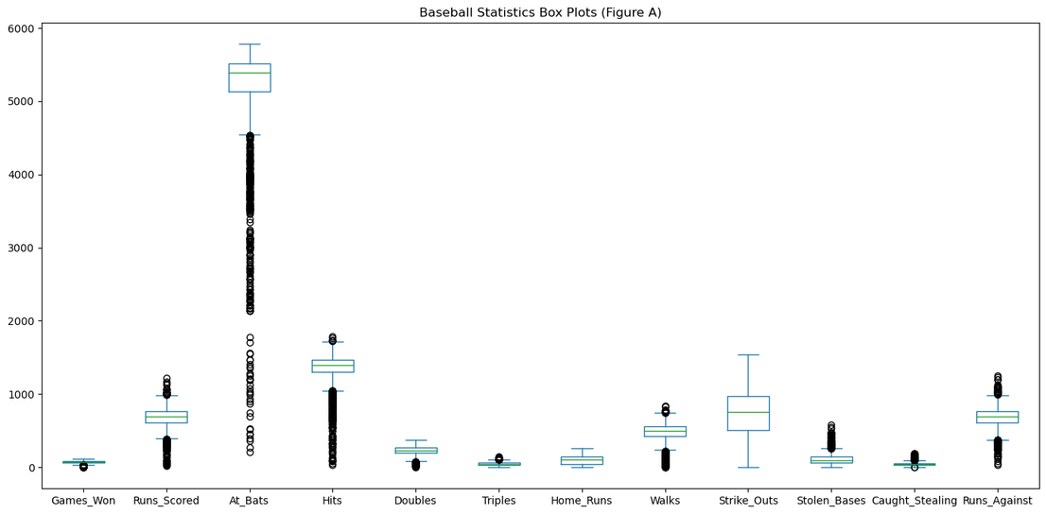
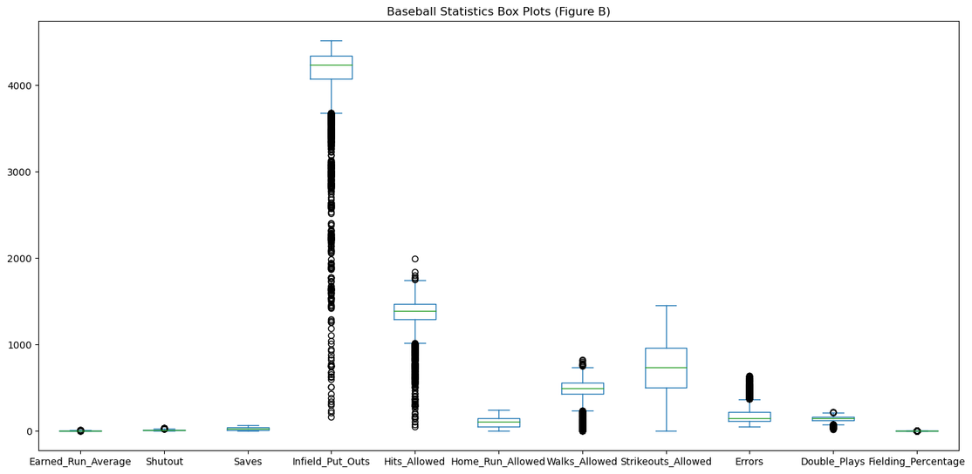
Exploratory Data Analysis
BOX PLOT ANALYSIS
BASEBALL STATISTICS
How do box plots help us analyze baseball statistics?
Observations
Helps visualize distribution of baseball metrics
Provides a clear representation of how data is spread, the central tendency, variability, and potential outliers
Allows for visual inspection of potential outliers that will help gain insights into important achievements, exceptional performance, anomolies or data quality issues
At Bats, Hits, Infield Put Outs and Hits Allowed are the most skewed metrics with many outliers and they do not have a normal distribution
Home Runs, Saves, Home Runs Allowed and Strikeouts allowed have the least amount of outliers and are normally distributed
Further analysis will be required to test data quality and anomolies

Slide 5
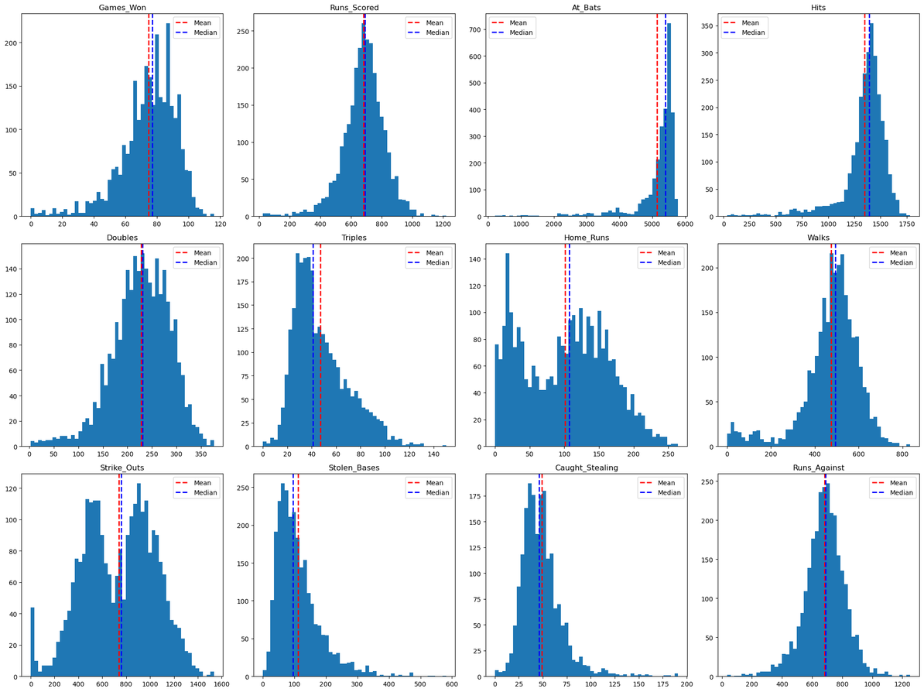
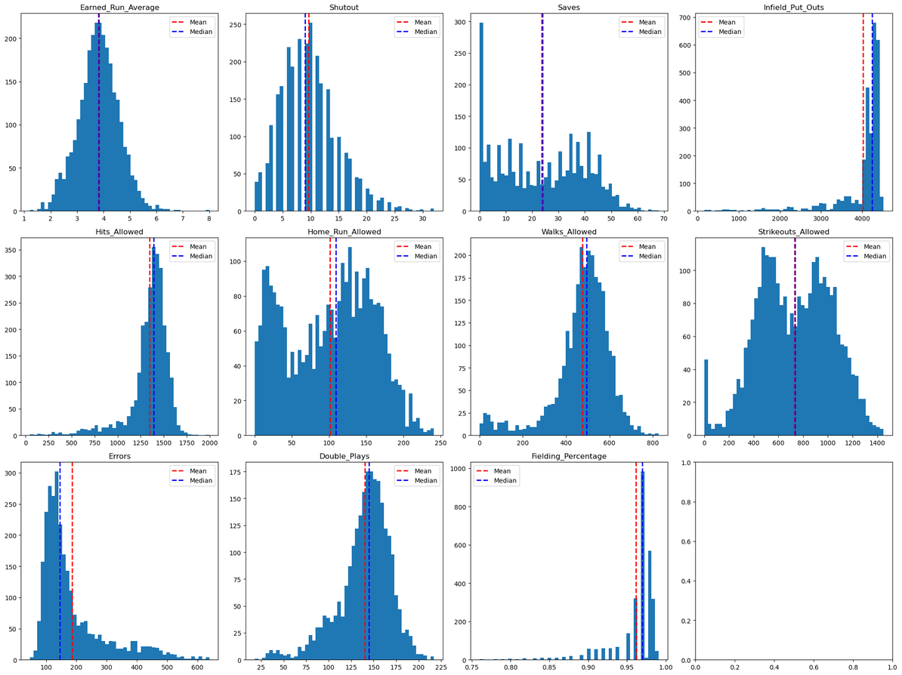
Exploratory Data Analysis
HISTOGRAM ANALYSIS
BASEBALL STATISTICS

Slide 6
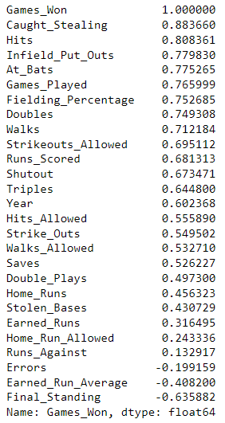
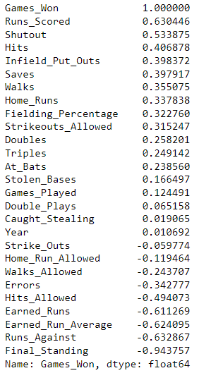
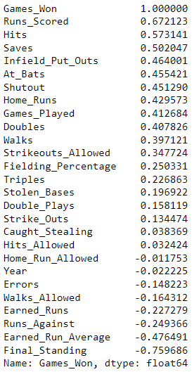
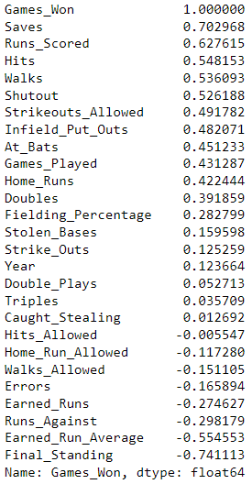
Correlation Analysis
BASEBALL STATISTICS
COVARIANCE
Covariance results for Periods 1-4 and variable selection
Purpose
We conducted a correlation analysis between 26 independent variables and the dependent variable (Games Won) for our baseball data frame. Our purpose is to:
Measure and understand the relationships between the variables
Quantify the strength and direction of the linear association
Provide insights into how changes in one variable correspond to changes in another
Period 1: Pre-1920
Period 2: 1920 - 1960
Period 3: 1960 - 1990
Period 3: 1990- 2010
Benefits
Identifying Predictive Factors
Understanding Relationships
Variable Selection for Predictive Modelling
Hypothesis Testing
Guiding Decision-Making
For linear regression modeling, we have picked the top 4 offensive metrics for the offensive model, the top 4 defensive metrics for the defensive model, and the top 2 offensive plus the top 2 defensive metrics for the balanced model for each period.

Slide 7
Variable Selection
PERIOD 1: PRE-1920
BASEBALL STATISTICS
Offensive Model
Defensive Model
Balanced Model
Offensive Metrics
Caught Stealing
Hits
At Bats
Doubles
Defensive Metrics
Infield Put Outs
Fielding Percentage
Strikeouts Allowed
Shutouts
Balanced Strategy
Caught Stealing
Hits
Infield Put Outs
Fielding Percentage

Slide 8
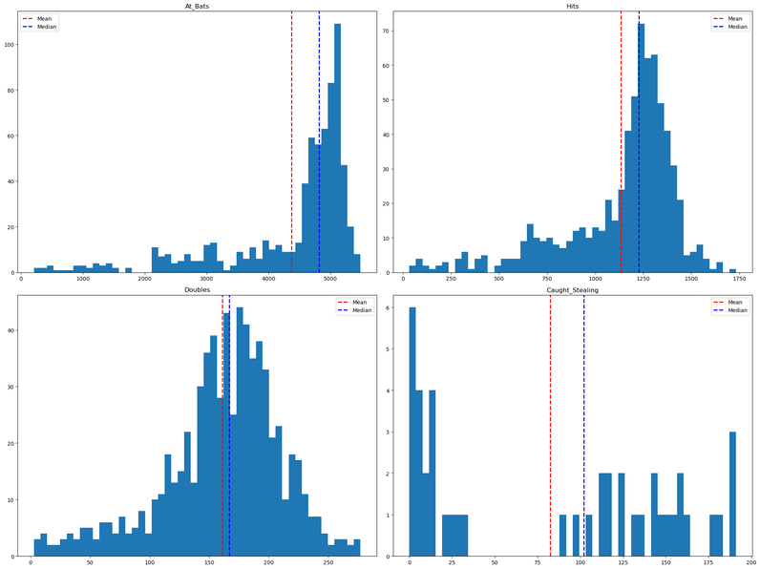
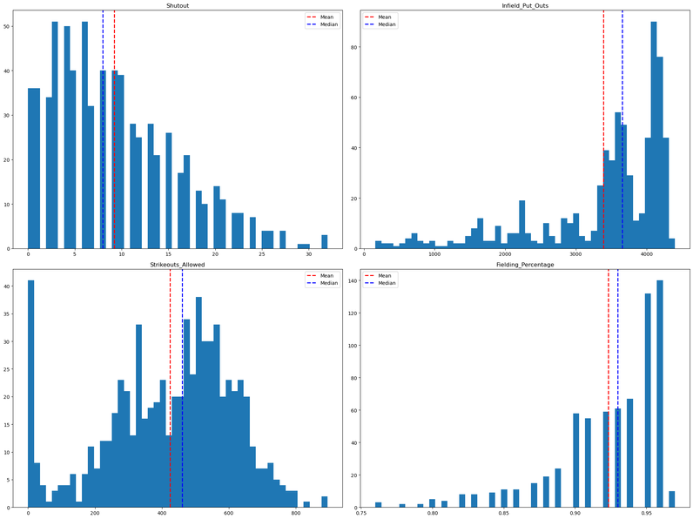
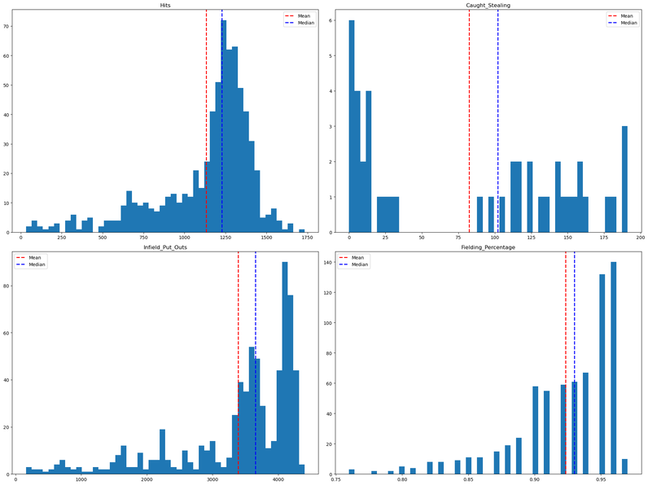
Linear Regression Modeling
PERIOD 1: PRE-1920
BASEBALL STATISTICS
Offensive Model
Defensive Model
Balanced Model

Slide 9
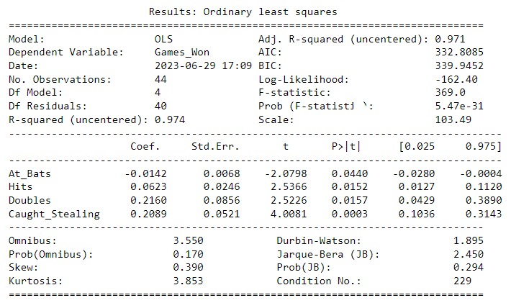
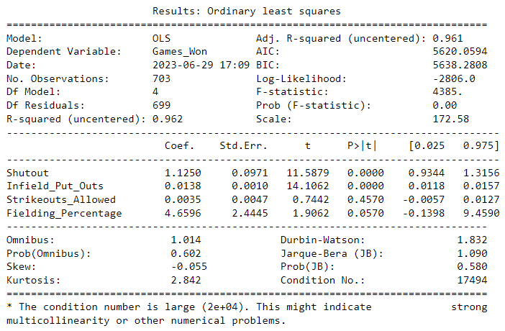
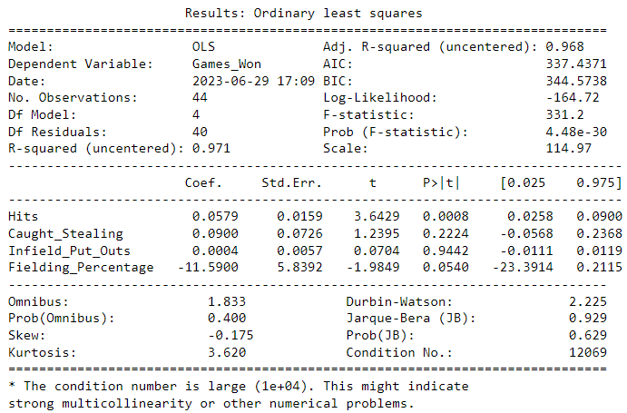
Linear Regression Modeling
PERIOD 1: PRE-1920
BASEBALL STATISTICS
Offensive Model
Defensive Model
Balanced Model

Slide 10
Variable Selection
PERIOD 2: 1920 - 1960
BASEBALL STATISTICS
Offensive Model
Defensive Model
Balanced Model
Offensive Metrics
Runs Scored
Hits
Walks
Home Runs
Defensive Metrics
Shutouts
Infield Put Outs
Saves
Fielding Percentage
Balanced Strategy
Runs Scored
Hits
Shutouts
Infield Put Outs

Slide 11
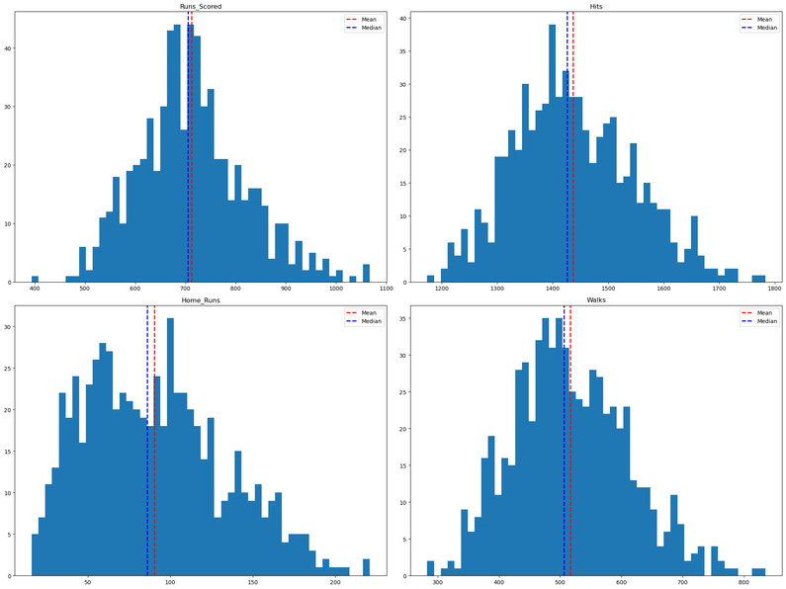
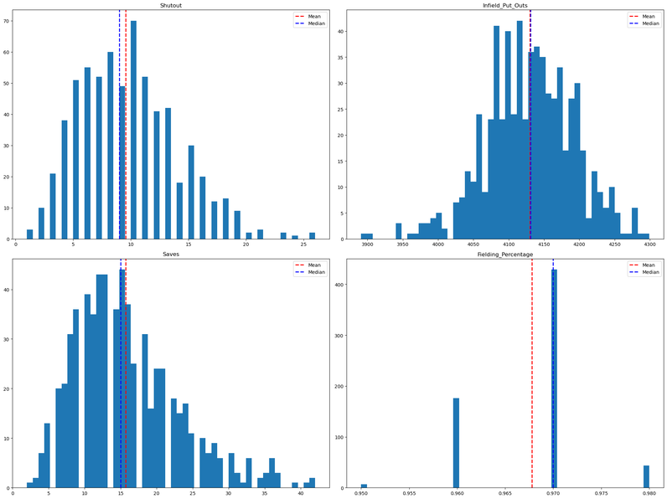
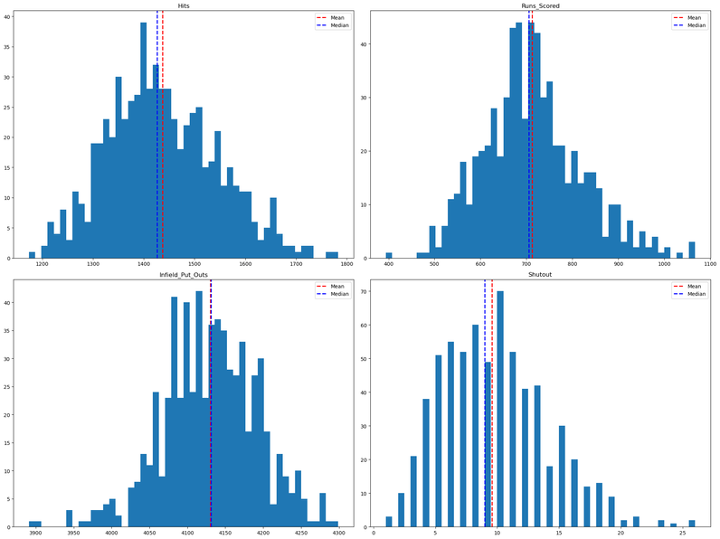
Linear Regression Modeling
PERIOD 2: 1920 - 1960
BASEBALL STATISTICS
Offensive Model
Defensive Model
Balanced Model

Slide 12
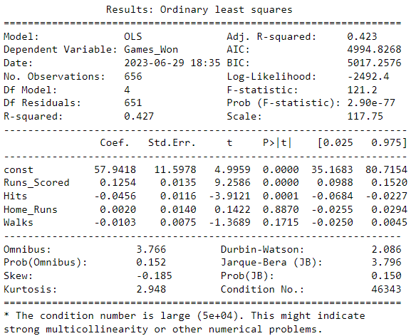
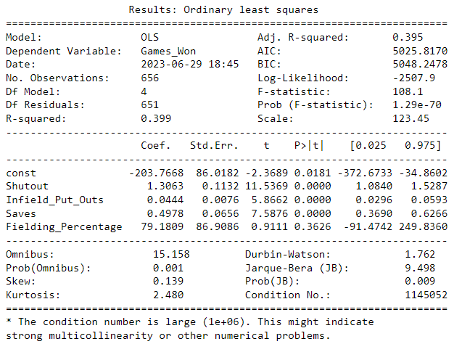
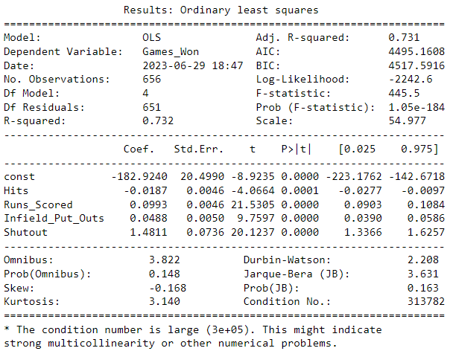
Linear Regression Modeling
PERIOD 2: 1920 - 1960
BASEBALL STATISTICS
Offensive Model
Defensive Model
Balanced Model

Slide 13
Variable Selection
PERIOD 3: 1960 - 1990
BASEBALL STATISTICS
Offensive Model
Defensive Model
Balanced Model
Offensive Metrics
Runs Scored
Hits
At Bats
Home Runs
Defensive Metrics
Saves
Infield Put Outs
Shutouts
Strikeouts Allowed
Balanced Strategy
Runs Scored
Hits
Saves
Infield Put Outs

Slide 14
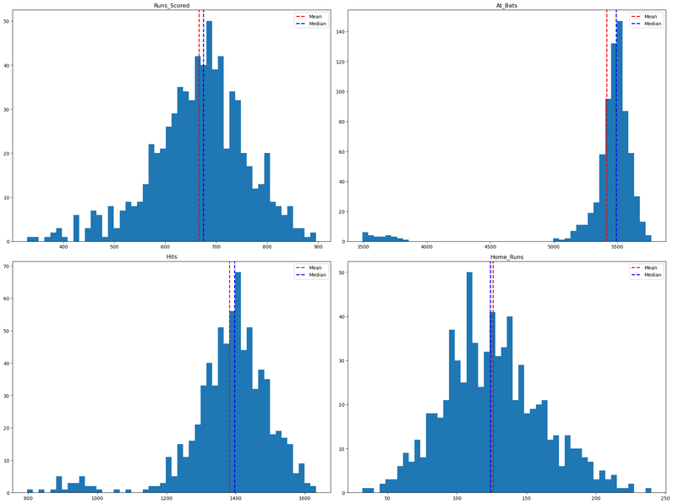
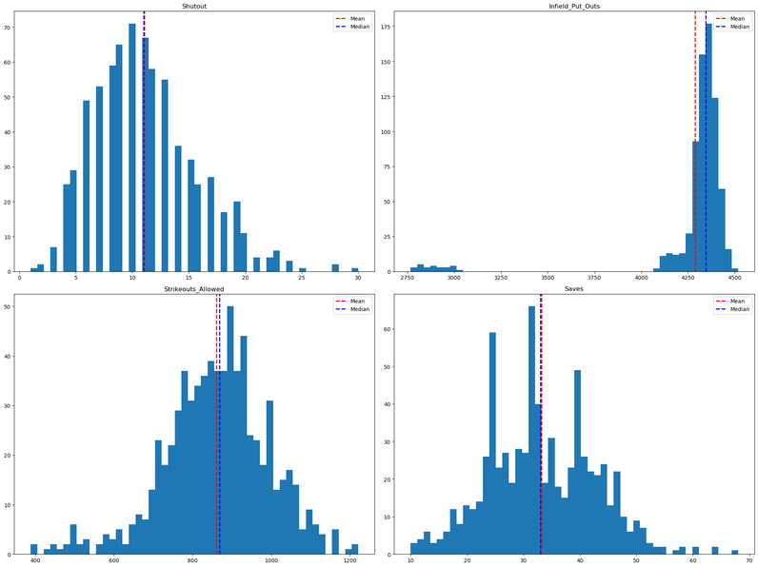
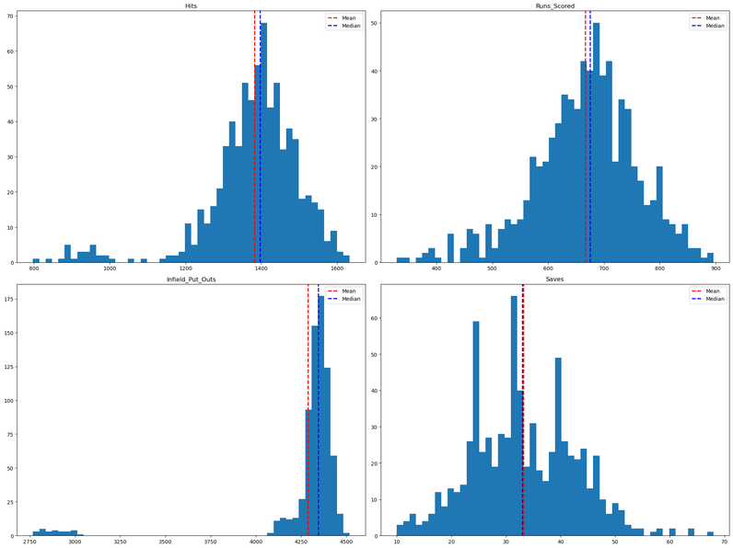
Linear Regression Modeling
PERIOD 3: 1960 - 1990
BASEBALL STATISTICS
Offensive Model
Defensive Model
Balanced Model

Slide 15
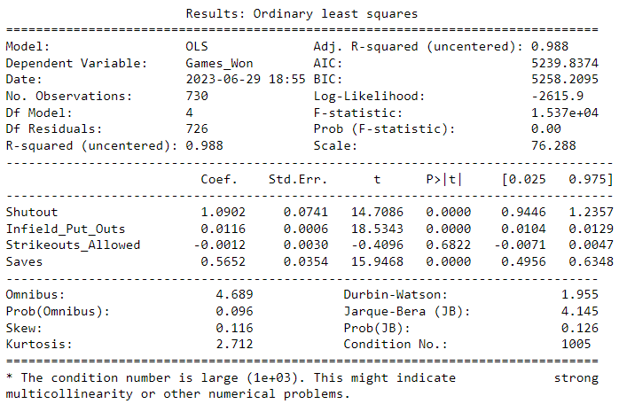
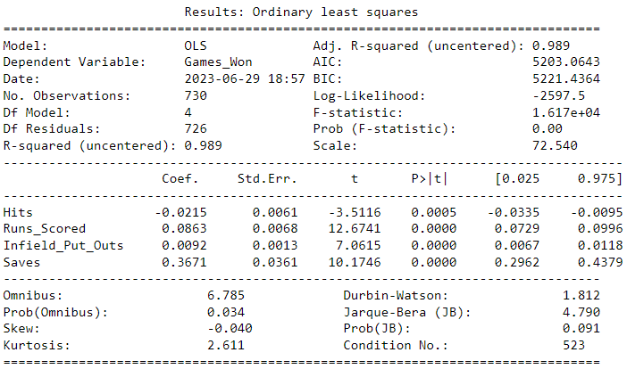
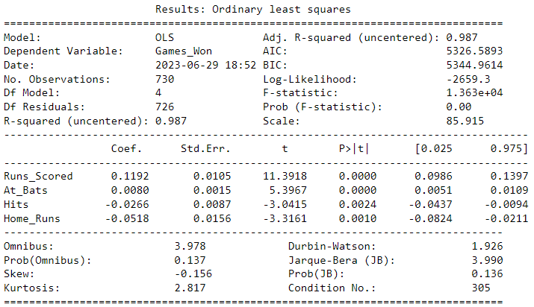
Linear Regression Modeling
PERIOD 3: 1960 - 1990
BASEBALL STATISTICS
Offensive Model
Defensive Model
Balanced Model

Slide 16
Variable Selection
PERIOD 4: 1990 - 2010
BASEBALL STATISTICS
Offensive Model
Defensive Model
Balanced Model
Offensive Metrics
Runs Scored
Hits
Walks
At Bats
Defensive Metrics
Saves
Shutouts
Strikeouts Allowed
Infield Put Outs
Balanced Strategy
Runs Scored
Hits
Saves
Shutouts

Slide 17
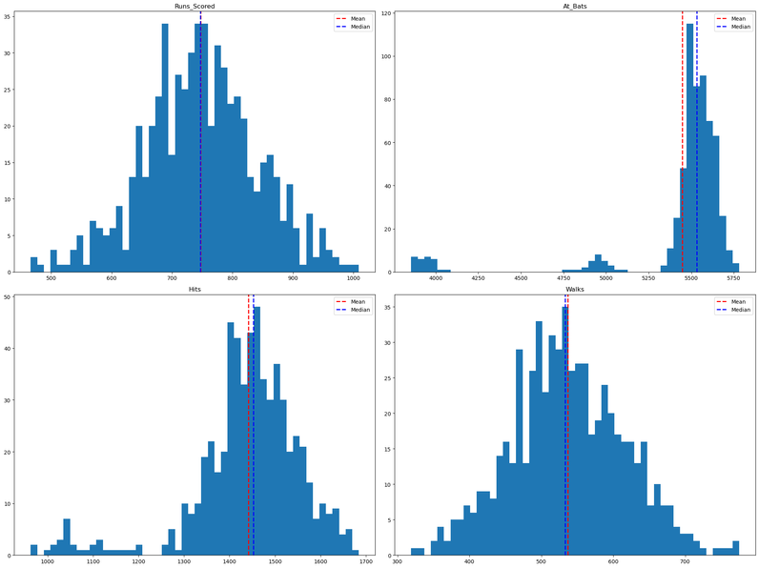
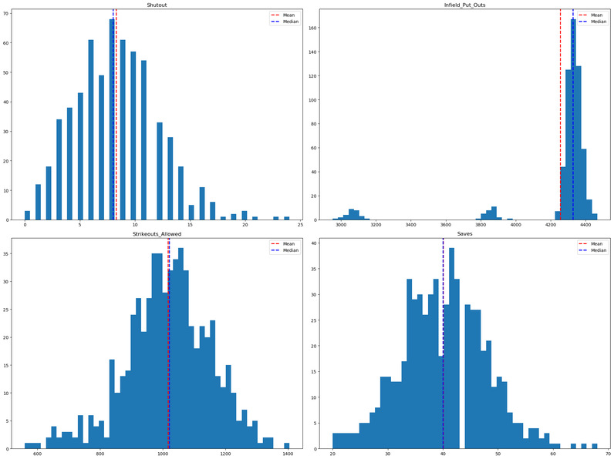
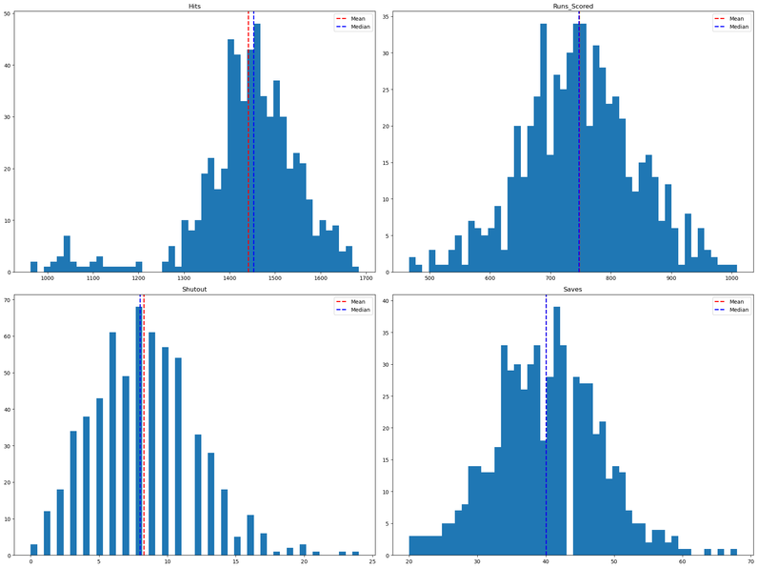
Linear Regression Modeling
PERIOD 4: 1990 - 2010
BASEBALL STATISTICS
Offensive Model
Defensive Model
Balanced Model

Slide 18
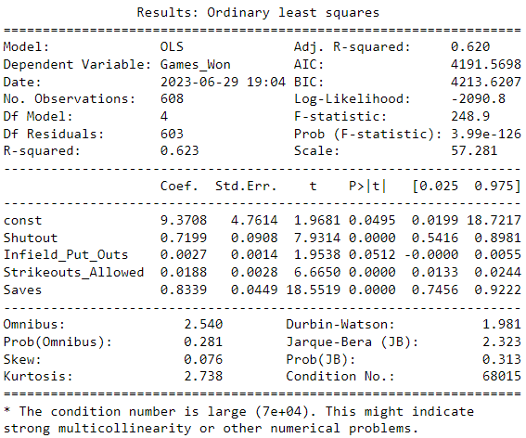
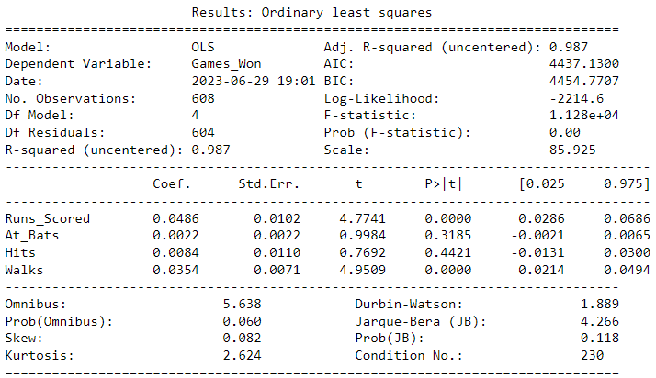
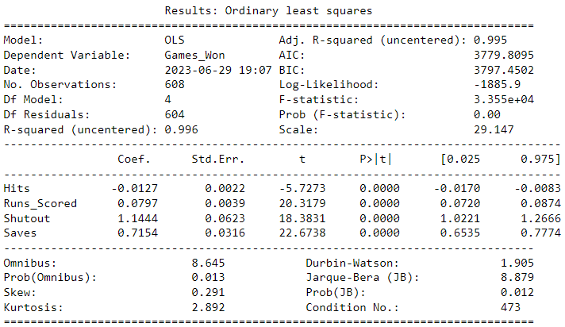
Linear Regression Modeling
PERIOD 4: 1990 - 2010
BASEBALL STATISTICS
Offensive Model
Defensive Model
Balanced Model

Slide 19
Linear Regression Results
RESULTS
BASEBALL STATISTICS
The following were the models that had the highest R^2 statistics:
Period 1 - Offensive Model: R^2 = 0.974
Period 1 - Defensive Model: R^2 = 0.962
Period 1 - Balanced Strategy Model: R^2 = 0.971
Period 3 - Offensive Model: R^2 = 0.987
Period 3 - Defensive Model: R^2 = 0.988
Period 3 - Balanced Strategy Model: R^2 = 0.989
Period 4 - Balanced Strategy Model: R^2 = 0.996
The following were significant predictors for games won:
Period 1: offensive strategies and defensive strategies
Period 2: offensive strategies and the balanced strategy
Period 3: offensive strategies, defensive strategies and the balanced strategy
Period 4: the balanced strategy
The following are trends that can help with a team's strategic decisions:
Offensive statistics Runs Scored, Hits and Home Runs were important predictors of games won
Defensive statistics Shutout, Infield Put Outs and Saves were important in some time periods
Overall, a balanced strategy that combined both offensive and defensive strategies showed great effectiveness in multiple time periods

Slide 20

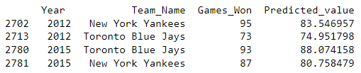
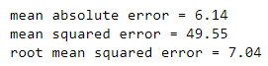
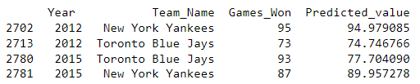
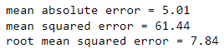

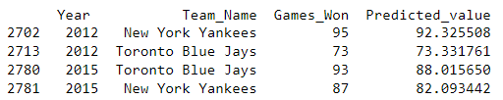
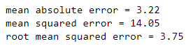
Predictive Models
BASEBALL STATISTICS
PREDICTIVE MODELS
Offensive
Model
Defensive
Model
Balanced
Model
Lower values of MAE, MSE, and RMSE indicate better model performance. The Balanced Model seems to be the best performing model among the three based on these metrics.

Slide 21



ANALYSIS
BASEBALL STATISTICS
CONCLUSION
Are there trends and patterns in the data for informed decision-making?
What are key offensive statistics that significantly affect the number of games won?
What are key defensive statistics that significantly affect the number of games won?
A balanced strategy combining both offensive and defensive factors showed effectiveness in various periods.
Runs Scored
Hits
Home Runs
Shutout
Infield Put Outs
Saves

